Slide 1

Using Data Science To Detect Fake News
Sai Sruthi Bodapati

Slide 2

Project Background &
Research Implications/Importance
Tedros Adhanom Ghebreyesus, the Director-General of the World Health Organization (WHO) to warn that:
We’re not just fighting an epidemic; we’re fighting an infodemic.
The impact of fake news can be deadly, causing mis-trust of news reporting on pandemics, giving rise to public behaviors(not wearing masks, social distancing) that have increased the spread of Coronavirus.

Slide 3


Research On:
What are simple text-based trends in the data that identify an article as fake vs. real?
Can we use machine learning to correctly classify whether an article is fake vs real via its text?
What is the polarity and subjectivity of the articles labeled fake vs real? Which is a better predictor of fake vs real news?
Overall, what implications can NLP and ML have on our society and how we ingest information?

Slide 4
Dataset
Data is news articles from ISOT Fake News Dataset.
The truthful articles were obtained by crawling articles from Reuters.com (News website). The fake news articles were flagged by Politifact (a fact-checking organization in the USA) and Wikipedia.
Python code utilizing machine learning algorithms to detect fake news
Fake news and real news dataset is from the Kaggle website
The website provided two datasets, true labeled news articles and fake labeled news articles

Slide 5
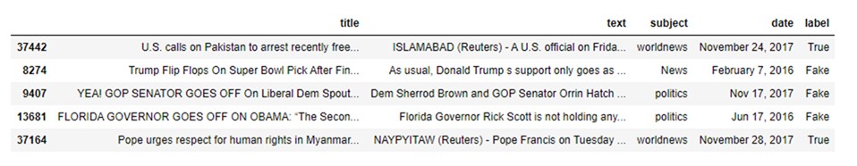
Dataset Sample
Dataset shows the index, title, text, subject, date, and label(True, Fake)
You will notice the subjective opinion in the samples labeled Fake
Used to influence viewers opinions on subjects

Slide 6
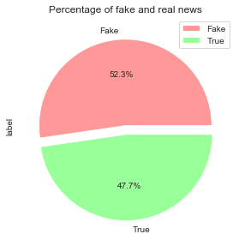
Data Set Balance
Balance of fake news articles and True news articles for training and testing data sets

Slide 7
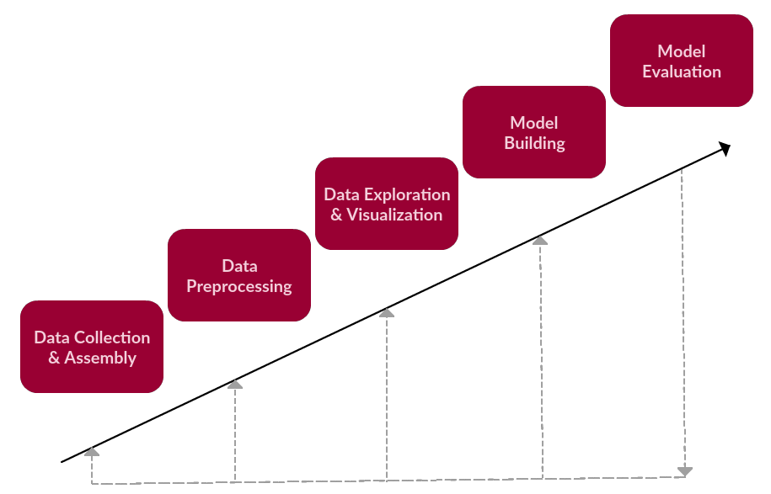
Overview
1. Data Processing
2. Data Exploration and Visualization
3. Vectorization
4. Model Creation and Evaluation
5. Sentiment Analysis
Notes:
more in detail
followed few steps of text mining

Slide 8

Data Importing and Preprocessing
Data Collection and importing Libraries: (fakes news and real news datasets) explain rationale
Data processing: check null values, filter and manipulate columns, adding labels (fake or real), and merge on selected columns
Preprocessing the text: NLP Approach
Text to features conversion

Slide 9
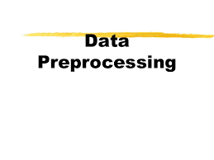
Corpus/Text data- Unstructured
Convert the text data into Lower case.
Tokenization-
Breaking down text into words.
Visualization
Removing punctuations, special chars,urls,numbers etc.
Removing stopwords-
Complete stop words
Lemmatization-
Converting the word to lemma(Root word) instead of just removing suffixes

Slide 10
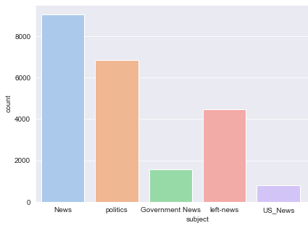
Summary Statistics - Fake News Subject Breakdown
Fake News Subjects:
News: 9050
politics: 6841
left-news: 4459
Government News: 1570
US_News: 783
Middle-east: 778

Slide 11
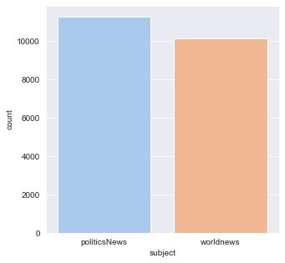
Summary Statistics - True News Subject Breakdown
True News Subjects:
politics news: 11272
world news: 10145

Slide 12
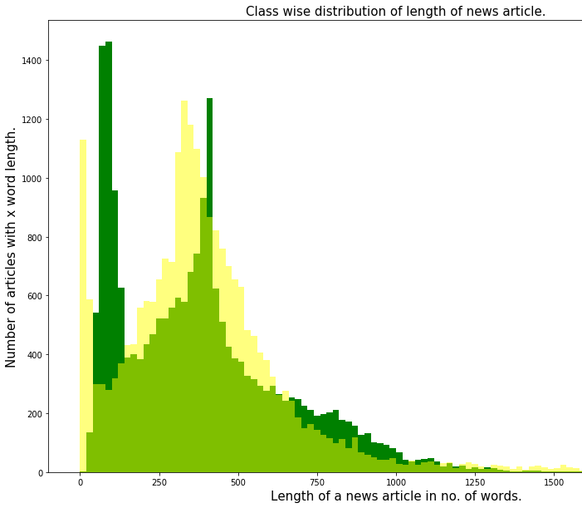
Summary Statistics - Article Length
Histogram bins the news articles together with same word length
Rarely, true news article contains more than 1400 words. On the contrary, there are comparatively much greater number of fake articles with word length more than 1400 words.

Slide 13
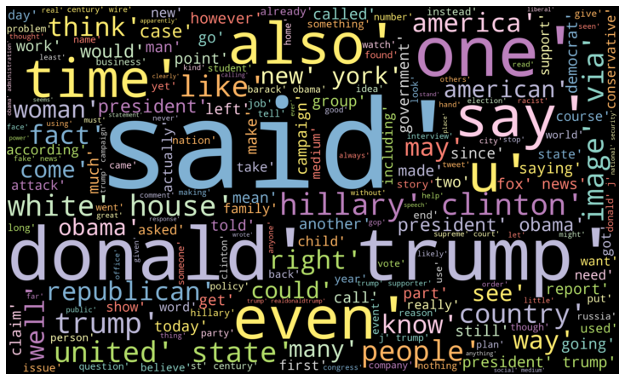
Word Cloud - Fake News

Slide 14
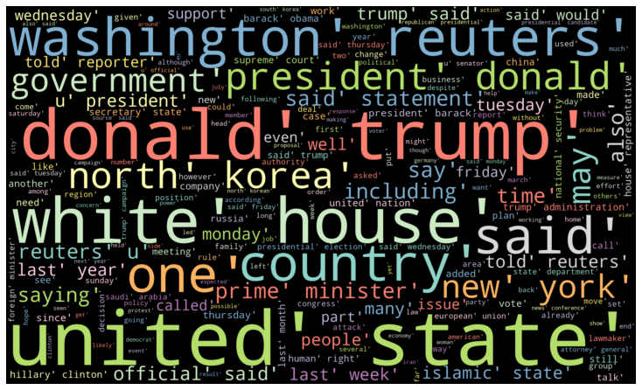
Word Cloud - True News

Slide 15
Sentiment Analysis
Sentiment analysis is extremely useful in social media monitoring as it allows us to gain an overview of the wider public opinion behind certain topics. ... Being able to quickly see the sentiment behind everything from forum posts to news articles means being better able to strategize and plan for the future.
sentiment analysis is used to find the author's attitude towards something. Sentiment analysis tools categorize pieces of writing as positive, neutral, or negative.

Slide 16
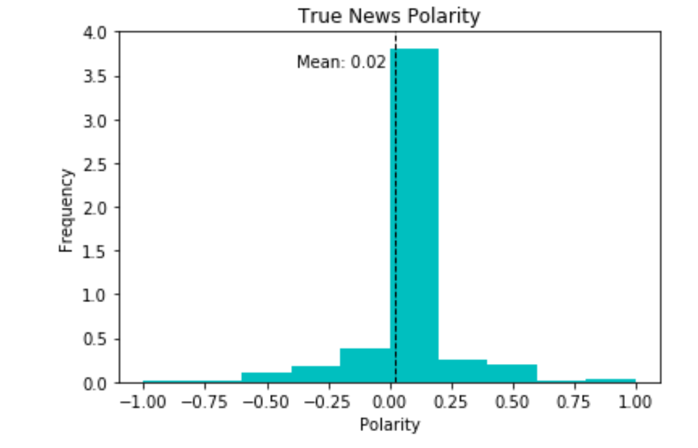
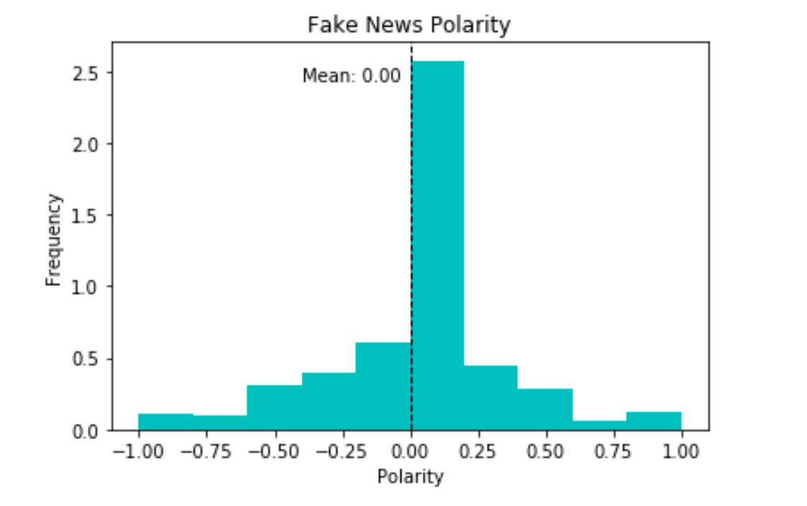
Sentiment Analysis: ‘Polarity’(Title)
Mean polarity of title/headlines is nearly identical & neutral regardless of fake/real news.
However, spread is higher for fake news (more extreme scores).

Slide 17
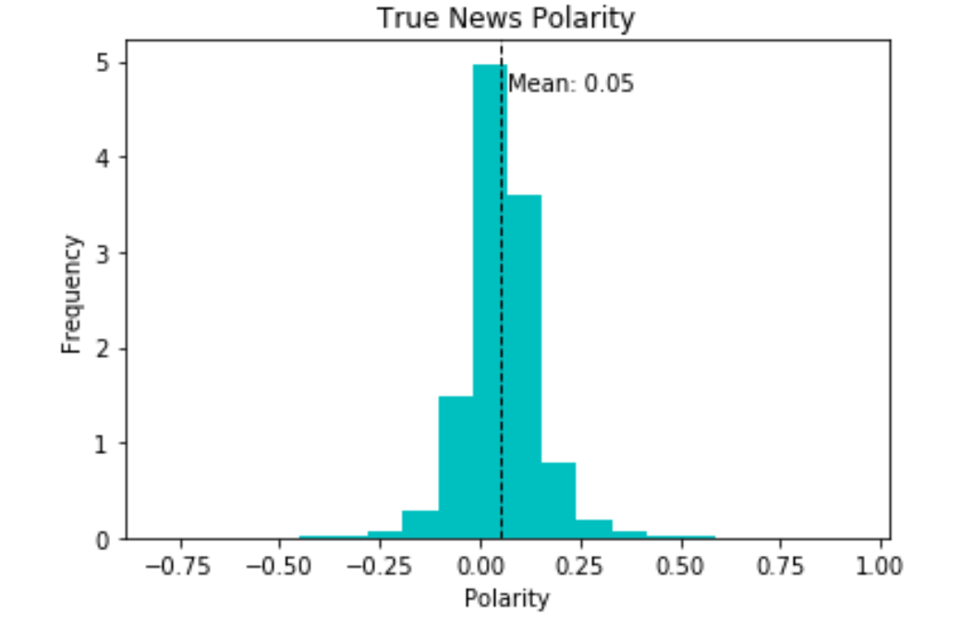
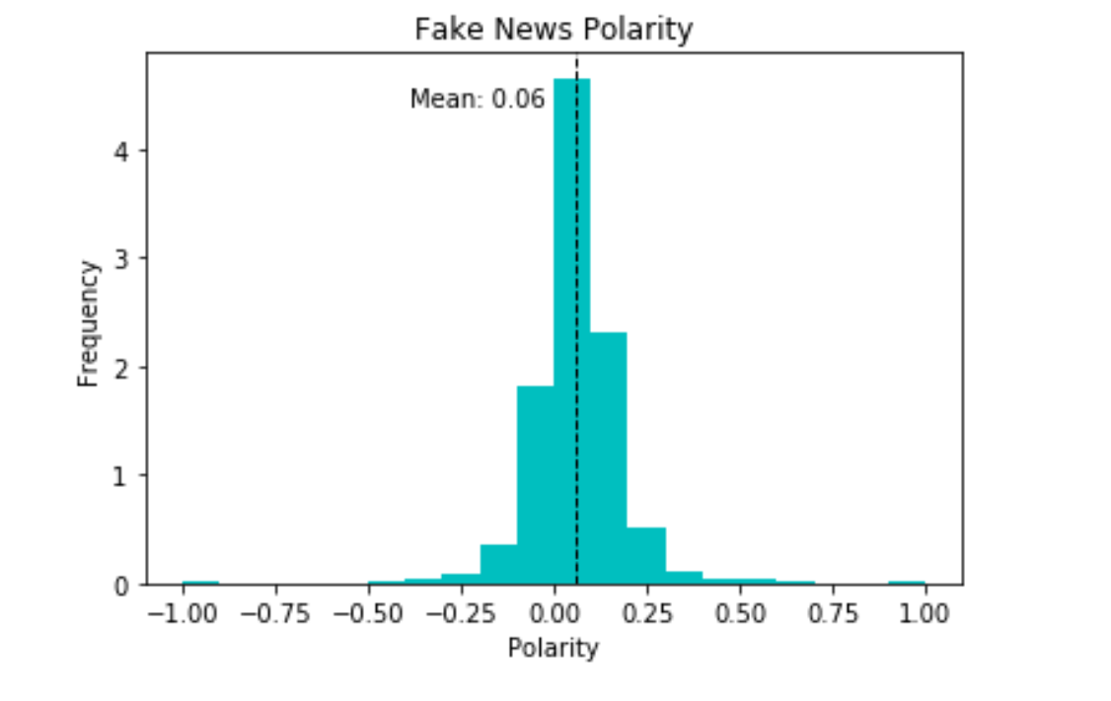
Sentiment Analysis: ‘Polarity’(Text)
Mean polarity of article text is nearly identical regardless of fake or real label and relatively neutral.
Spread is similarly identical. Is subjectivity a better predictor?

Slide 18
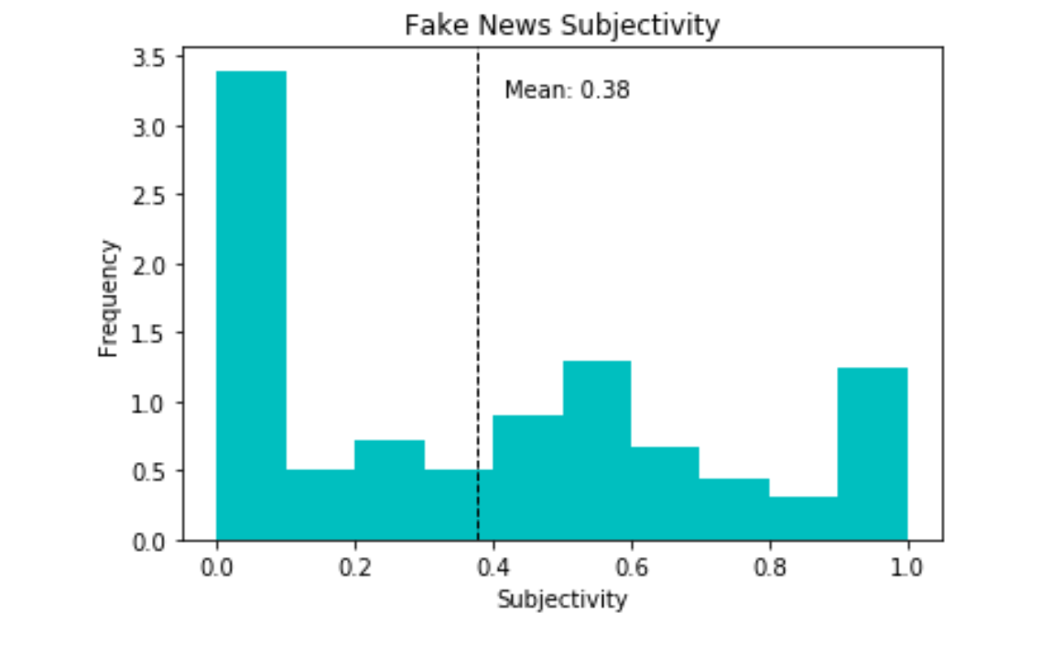
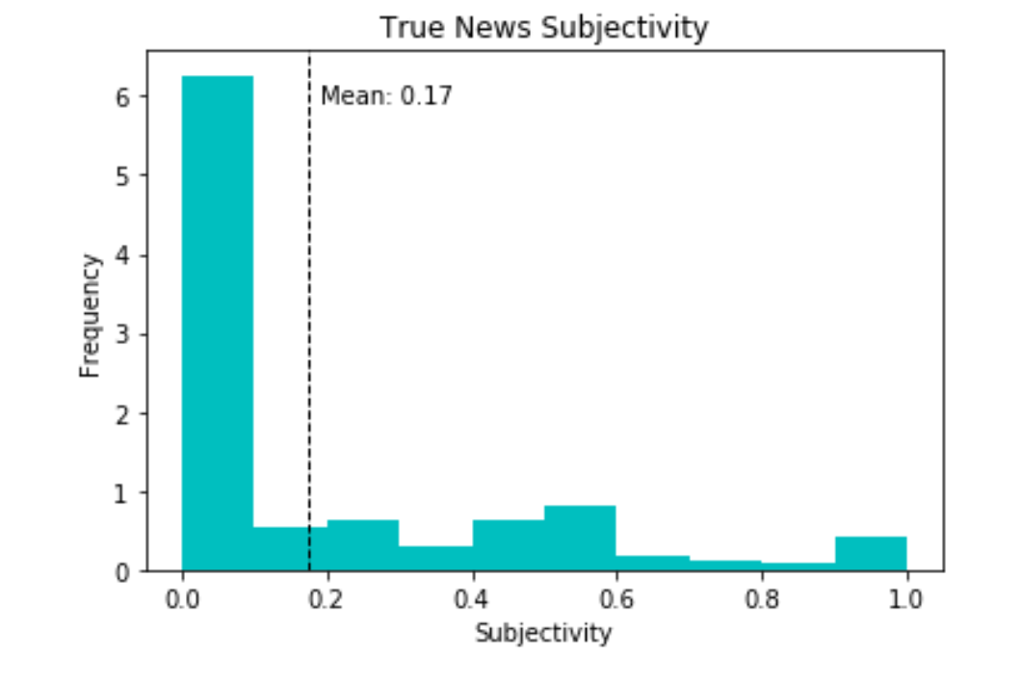
Sentiment Analysis: ‘Subjectivity’(Title)
Greater spread of subjectivity scores for fake news and differences in mean (more subjective).
True news tend to be more objective based on title/headlines.

Slide 19
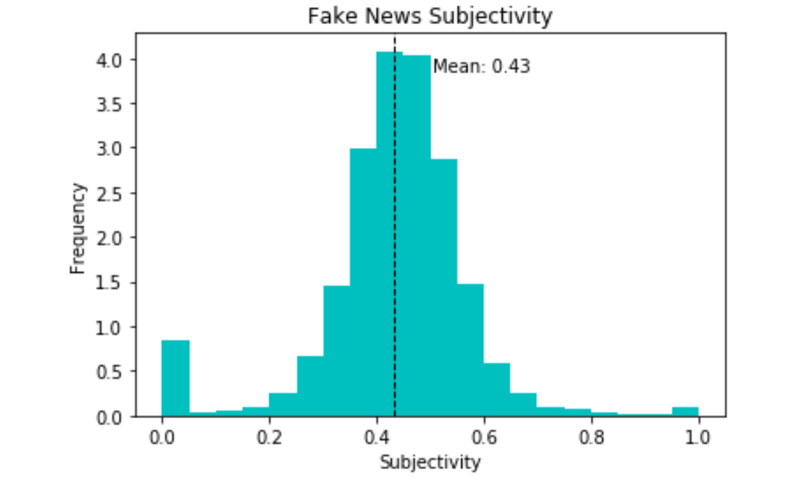
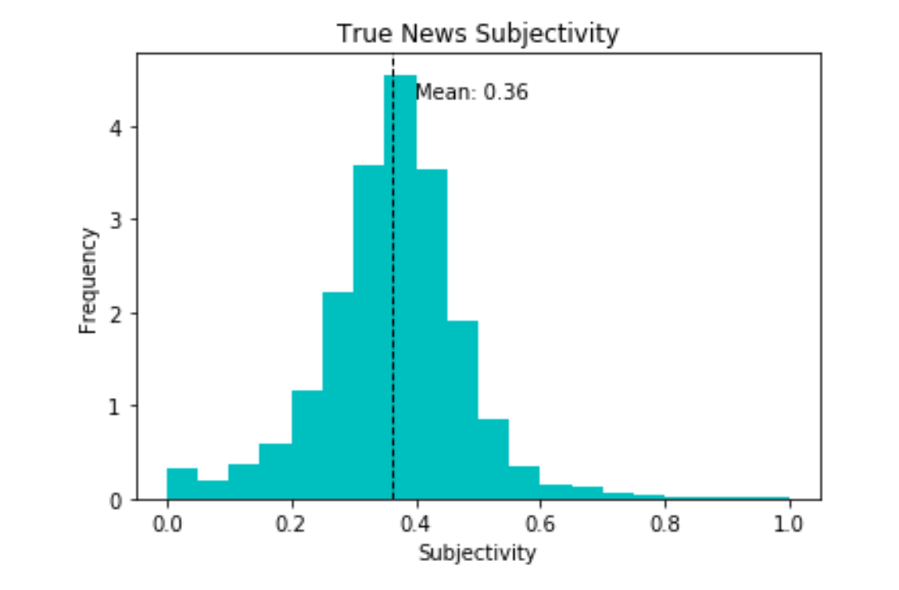
Sentiment Analysis: ‘Subjectivity’(Text)
Looking at article text, (though means similar), more fake news articles have scores > 0.4 (more subjective). Slight left-skew.
More real news articles have scores < 0.4 (more objective). Slight right-skew.

Slide 20
Text Vectorization
CountVectorizer
Word counts!
How often does a given word appear within a document?
TfidfVectorizer
Word frequencies!
Downscales words that appear a lot across documents (like “the”).
Notes:
Text Vectorization is the process of converting text into numerical representation.

Slide 21
Fake news detection using naive Bayes classifier
Goal: Want to attempt creating machine learning algorithm to detect fake news.
Key Terms:
Naive Bayes - Based on Bayes’ Theorem, describes the probability of an event, based on prior knowledge of conditions that might be related to the event.
CountVectorizer - Word count vectorization.
TfidfVectorizer - Word frequency vectorization.

Slide 22
Naive Bayes Classifier
Based on Bayes’ Theorem: P(A|B) = P(B|A) × P(A) / P(B)
Widely used in text classification problems and fast, simple, and intuitive!
Tried Random Forest (multiple decision trees, but too slow!)
Assumes each feature (word) is independent of each other.

Slide 23
Process
Download Dataset and Load into Jupyter Notebook
Vectorize! Apply CountVectorizer & Tfidfvectorizer
Test on Holdout Set
Step 1
Step 3
Step 5
Step 2
Step 4
Step 6
Multinomial Naive Bayes
Randomize and Split Datasets into Training (80%) and Testing (20%) Sets
Determine Accuracy

Slide 24
Process
Download Dataset and Load into Jupyter Notebook
Vectorize! Apply CountVectorizer & Tfidfvectorizer
Test on Holdout Set
Step 1
Step 3
Step 5
Step 2
Step 4
Step 6
Multinomial Naive Bayes
Randomize and Split Datasets into Training (80%) and Testing (20%) Sets
Determine Accuracy

Slide 25
Process
Download Dataset and Load into Jupyter Notebook
Vectorize! Apply CountVectorizer & Tfidfvectorizer
Test on Holdout Set
Step 1
Step 3
Step 5
Step 2
Step 4
Step 6
Randomize and Split Datasets into Training (80%) and Testing (20%) Sets
Multinomial Naive Bayes
Determine Accuracy

Slide 26
Process
Download Dataset and Load into Jupyter Notebook
Vectorize! Apply CountVectorizer & Tfidfvectorizer
Test on Holdout Set
Step 1
Step 3
Step 5
Step 2
Step 4
Step 6
Randomize and Split Datasets into Training (80%) and Testing (20%) Sets
Multinomial Naive Bayes
Determine Accuracy

Slide 27

Results
“The multinomial Naive Bayes classifier is suitable for classification with discrete features (e.g., word counts for text classification). The multinomial distribution normally requires integer feature counts. However, in practice, fractional counts such as tfidf may also work”
Multinomial Naive Bayes
 | 👑 CountVectorizer 👑 | TfidfVectorizer
Accuracy | 0.952561 or 95.26% | 0.935523 or 93.55%
Precision | 0.952579 | 0.935517
Recall | 0.952561 | 0.935523
F1 | 0.952566 | 0.935514

Slide 28
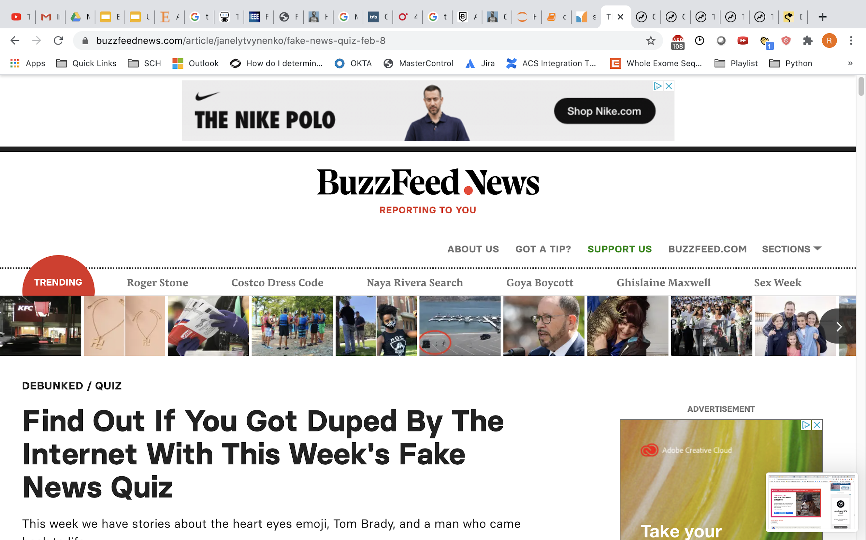
Putting model to the test!
Try it yourself

Slide 29
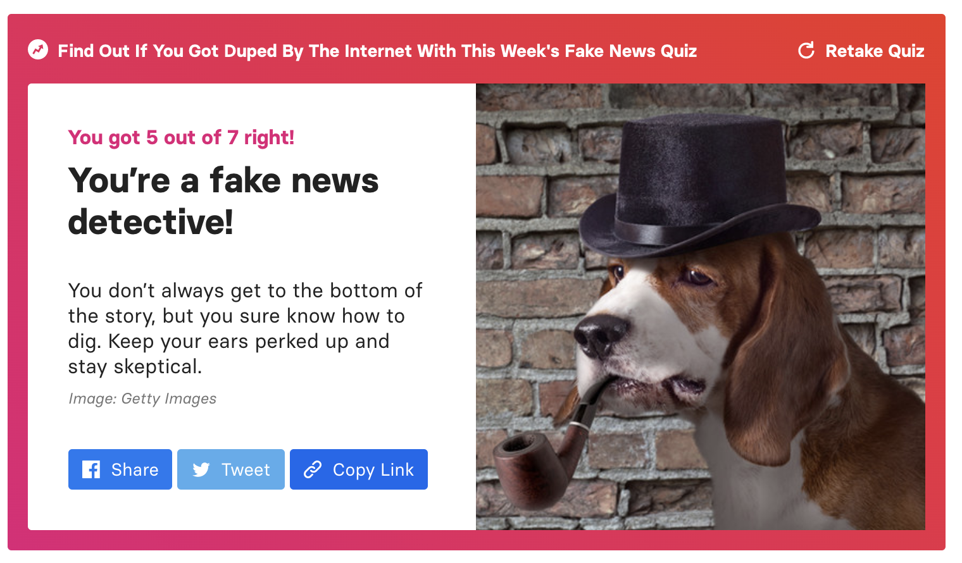
Results
5/7 or 71%! :(
Need to broaden training data.
Stumped by sensationalist (but true) titles.
“A man who was revived from a drug overdose stole and crashed a police cruiser.”
“A woman found a man she didn't know in her apartment closet, wearing her clothes.”
However, was able to guess correctly when full articles/text were inputted (not just headlines).

Slide 30
Conclusion
What are simple trends in the data that identify an article as fake vs. real?
Fake news articles tend to be longer!
Fake news articles contain more names/nouns, while real news articles contains more dates and locations.
What is the polarity and subjectivity of the articles labeled fake vs real?
Less differences in median or mean polarity, though more spread in the data for fake news.
Fake news articles have higher subjectivity scores.
Can we use machine learning to correctly classify whether an article is fake vs real?
Yes! However, there are a wide variety of news articles beyond the subjects analyzed in this dataset. Need to broaden training dataset and explore relationship between words.
Also, examine subjectivity as a predictor in next iteration.
Overall, what implications can NLP and ML have on our society and how we ingest information?
Yes! Information overload + Multiple Sources (News Agencies, Google, Facebook, Twitter…) = Need automated solutions.

Slide 31
Conclusion (Non-Data Science) When all else fails, Google the headline of the article and see if there are results indicating it’s a fake news article ;)
The CRAAP Test - In … of a world run thru algorithms to detect fake news and label as fake, you can use this guide to help differentiate.
CRAAP test is an acronym that stands for a series of questions you should ask yourself whenever you encounter a different information source to test its reliability.
Currency: Is the information out of date for what you are researching?
Relevance: Is the information relevant to what you are looking for.
Authority: Are the authors of the information source a qualified authority. Example searching for coronavirus , read article by epidemiologists.
Accuracy: Do the facts come from a reputable source?
Purpose: What is the purpose of the article? Is it to present the news or an opinion, or entertain?

Slide 32
Thank You

